Slide 1
Data Point Modelling as future
ISO standard for financial Big Data
48th World Continuous Auditing and Reporting Symposium
Banco de España | Online via Webex | Madrid, Spain | September 24 & 25, 2020
Ignacio Boixo
CEN, eBusiness Coord. Group
ignacio@boixo.com
Javier Mora
XBRL Spain
javier.mora@xbrl.es

Slide 2

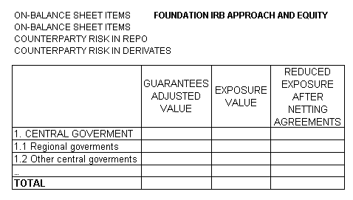
Data mapping V
Introduction to DPM
Issues of concern at COREP (COmmon REPorting, EU Banking Superv.) Guillermo Rodriguez, 15 Sept. 2004
COREP
Every position inside one template can be located as a connection of items of all involved objects.
EXPOSURE
TYPES ITEM
position
EXPOSURE
CLASSES ITEM
CRM
TECHNIQUES ITEM

Slide 3
Introduction to DPM
Data Model for Common Reporting. Frédéric Marie (BdF), Adrian Abbot (UK FSA). Banking Supervisors Workshop. Feb. 2005

Slide 4
Introduction to DPM

Slide 5
Introduction to DPM
A communication gap between business users, in charge of expressing reporting requirements, and technical experts, in charge of developing XBRL taxonomies, has been identified as a crucial problem on COREP and FINREP projects.

Slide 6
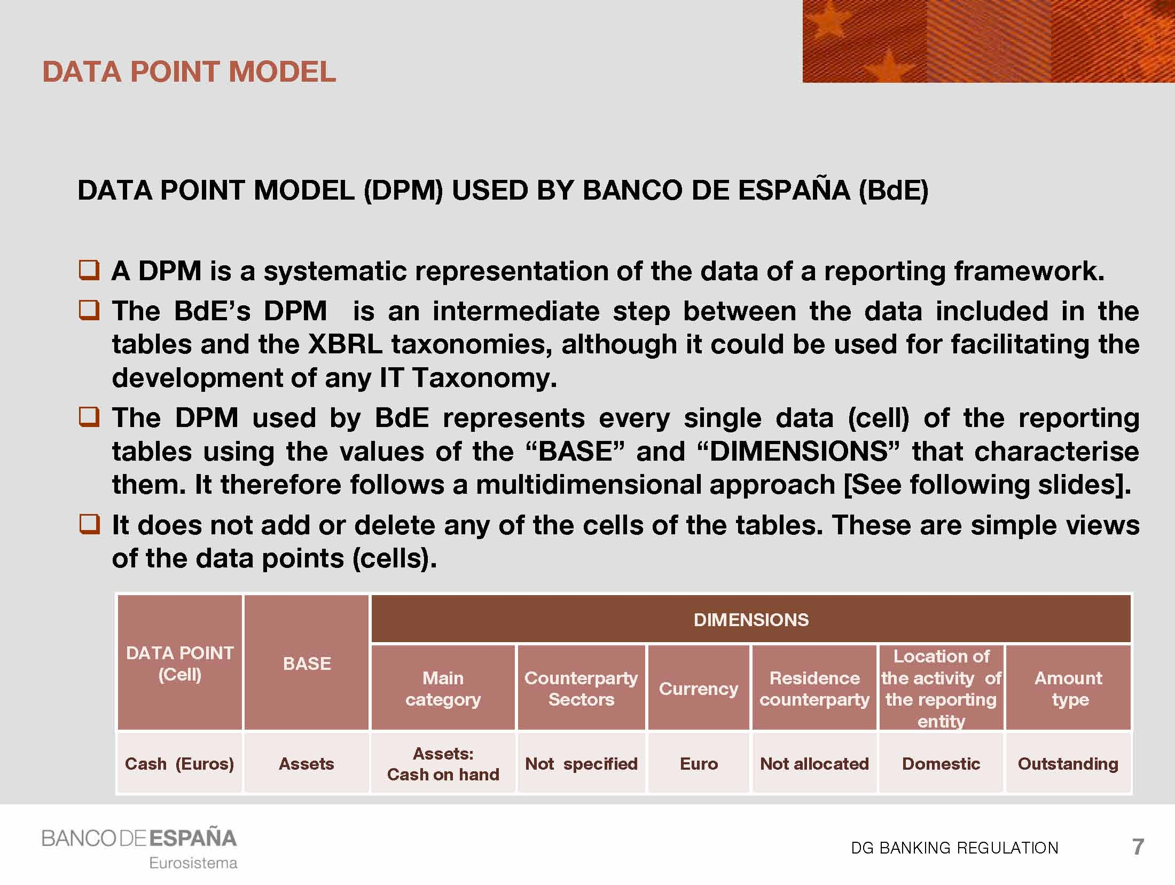
Introduction to DPM
Banco de España’s Data Point Model for collecting data for BSI/MIR statistics using XBRL. July 2010

Slide 7
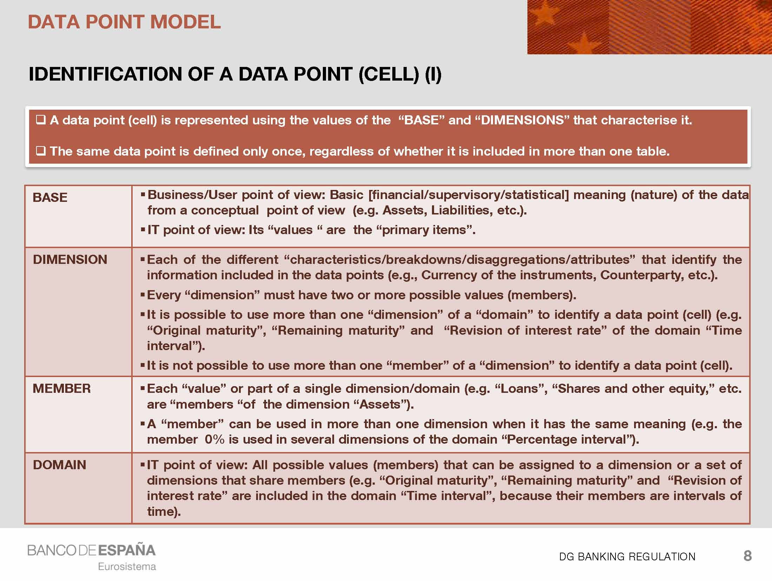
Introduction to DPM
Banco de España’s Data Point Model for collecting data for BSI/MIR statistics using XBRL. July 2010

Slide 8
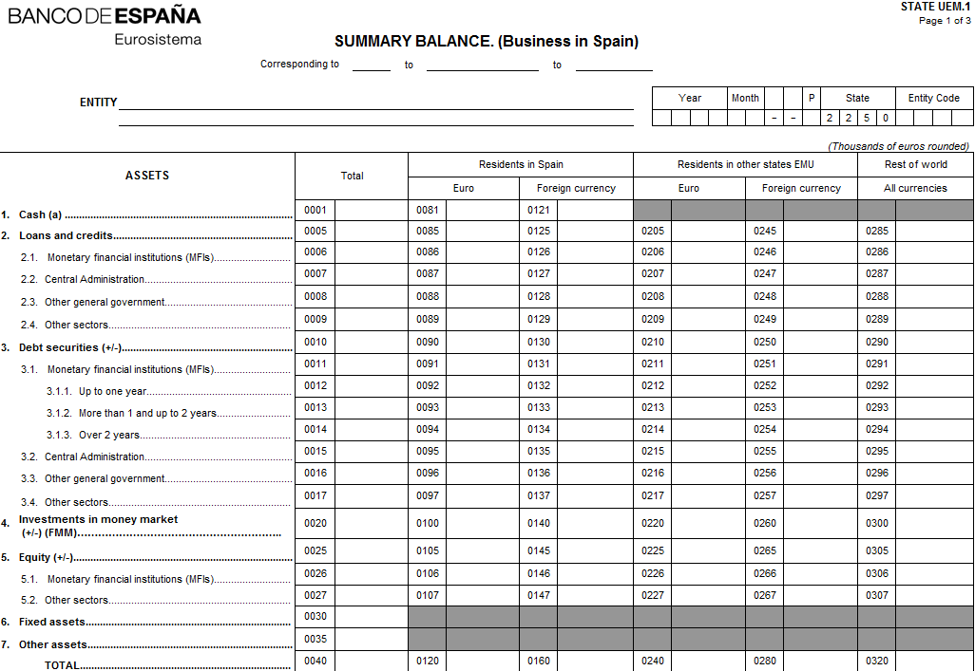
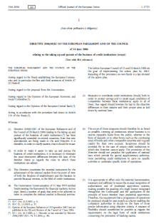
Introduction to DPM
Data Point Model example
PrimaryItem: Assets
Category of assets: Debt securities
Counterparty sector: Monetary Financial Institutions
Original maturity: ≥ 1 year < 2 year
Counterparty residence: Spain
Instrument original currency: EUR
Location of activity: Spain
Amount type: Outstanding

Slide 9
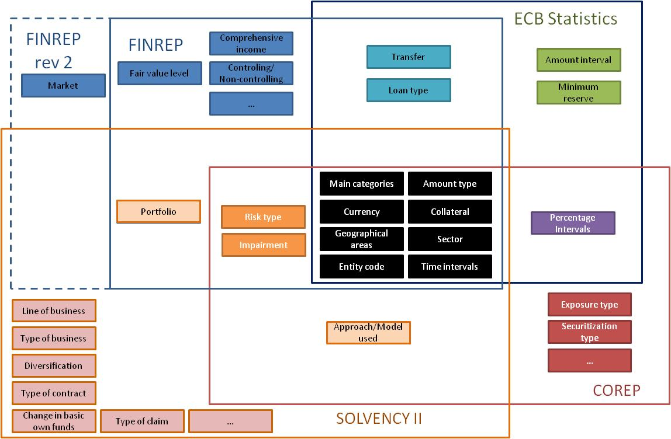
Introduction to DPM
Data Point Model reconciliation
Ochocki, B. et al. (2011)

Slide 10



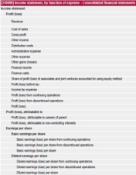


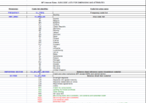

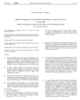
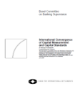
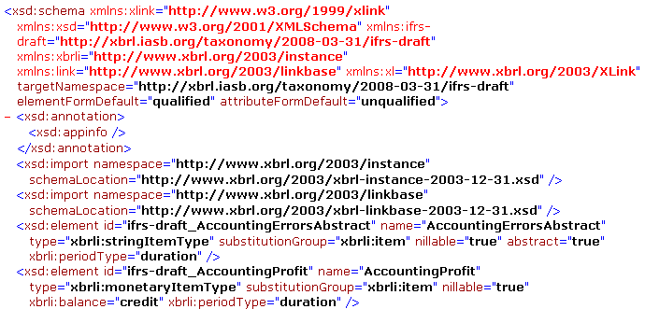

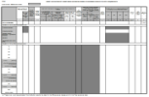

Introduction to DPM
Data Point Model use case
reporting
entity
Data
Point
Model
Data exchange format:
XBRL taxonomy
Data requirements
+ concepts definitions
supervisor
data
analysis and audit

Slide 11
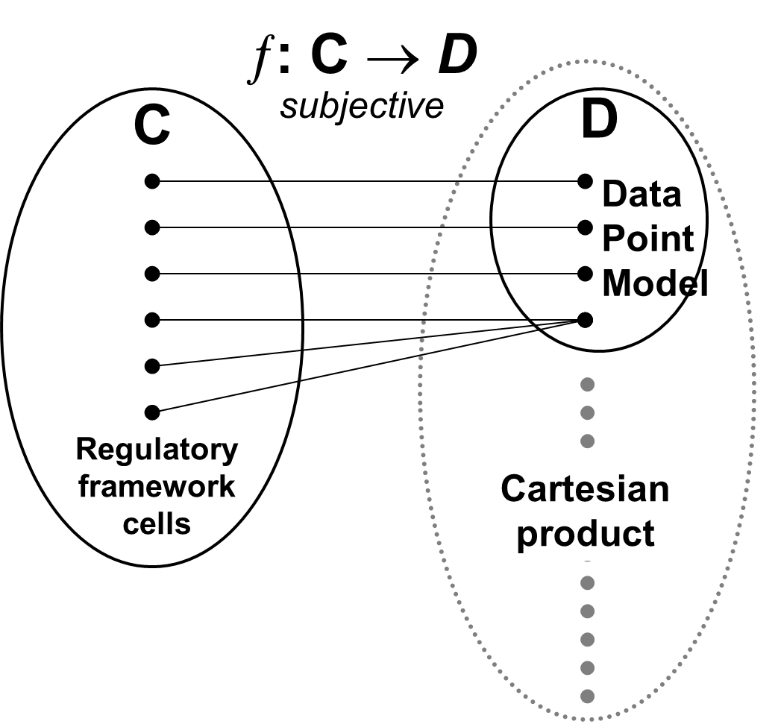
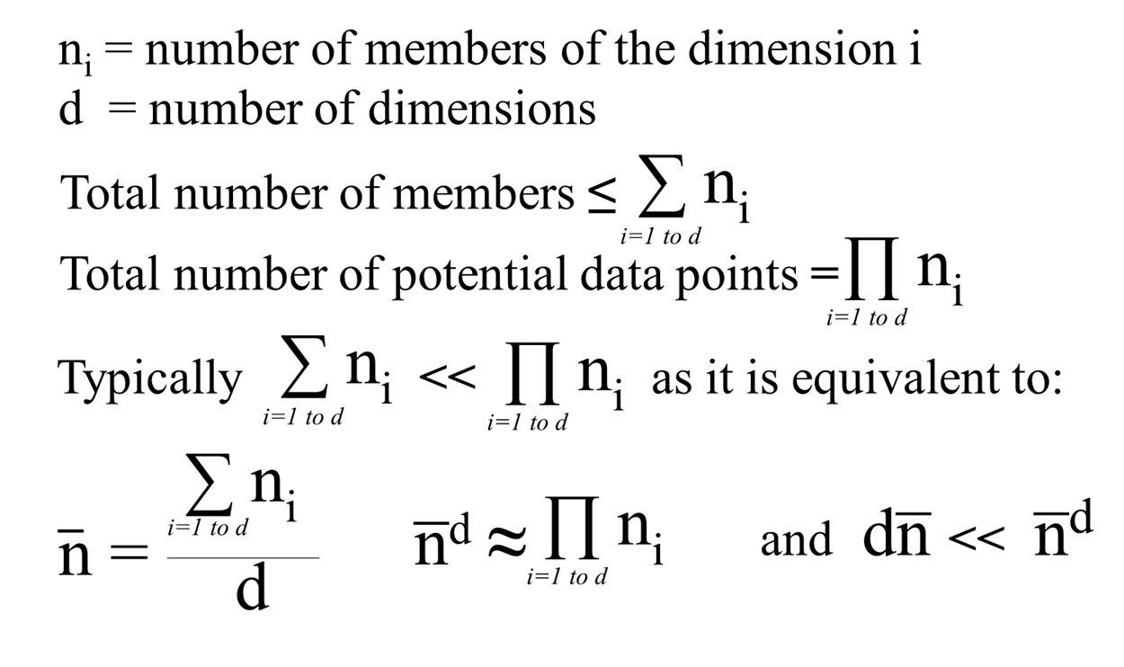
Introduction to DPM
Methodology of Data Point Model in European Banking Supervision
Ignacio Boixo. Malatya, 3rd May 2012.
24th World Continuous Audition and Reporting Symposium

Slide 12
Introduction to DPM
European Data Point Methodology for supervisory reporting. April 2014. Dr. Ignacio Santos et al.

Slide 13
DPM: from CEN standard to ISO standard

Slide 14




DPM: current situation
Who is using DPM in Europe?
https://eba.europa.eu/risk-analysis-and-data/reporting-frameworks
https://www.eiopa.europa.eu/tools-and-data/supervisory-reporting-dpm-and-xbrl_en
https://www.bankingsupervision.europa.eu/banking/approach/reporting/html/index.en.html
https://srb.europa.eu/en/content/reporting

Slide 15
DPM: current situation
Stages in the implementation of an XBRL taxonomy following the DPM methodology
1. Information requirements
Business templates (usually in spreadsheet format)
2. DPM
Methodology for creating the reporting model
3. XBRL
The technology for the creation of the taxonomy

Slide 16
DPM: current situation
DPM methodology
Documentation
Filing rules
DPM database
Annotated templates
Changes between versions
Sample files
Validations
Constrains
Additional rules
Guidance
Tables
Formulas
Variables and filters
Severity
Error messages
Data dictionary
Axis (open and close)
Coordinates
Grey cells
Filing indicators
Domains
Hierarchies
Dimensions
Members
Step 05
Step 04
Step 03
Step 02
Step 01
Notes:
© Copyright Showeet.com – Free PowerPoint Templates

Slide 17
DPM: current situation
DPM tools
In order to work with DPM we need to use XBRL tools.
XBRL 2.1 + Dimensions + Enumerations + Table linkbase + Formulas + Filing rules + Taxonomy package
Validation
Visualization and creation
Instances
Creation from scratch and extension of existing taxonomies
Taxonomies
List of available commercial & open source tools in https://eurofiling.info/portal/xbrl-solutions/

Slide 18

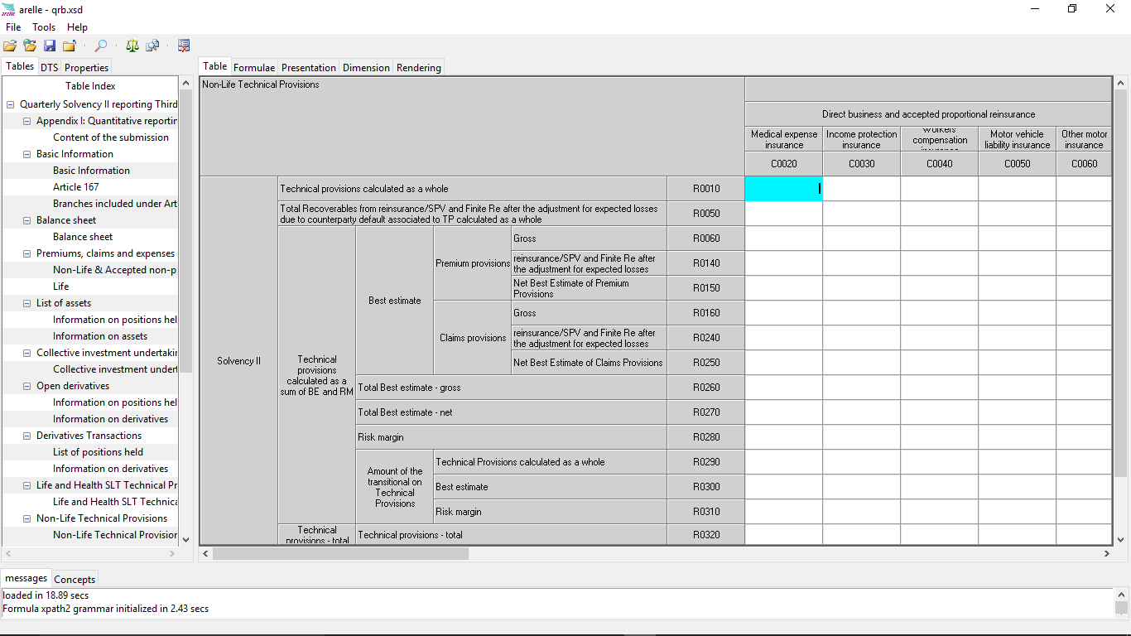
DPM: current situation
DPM tools
https://arelle.org

Slide 19

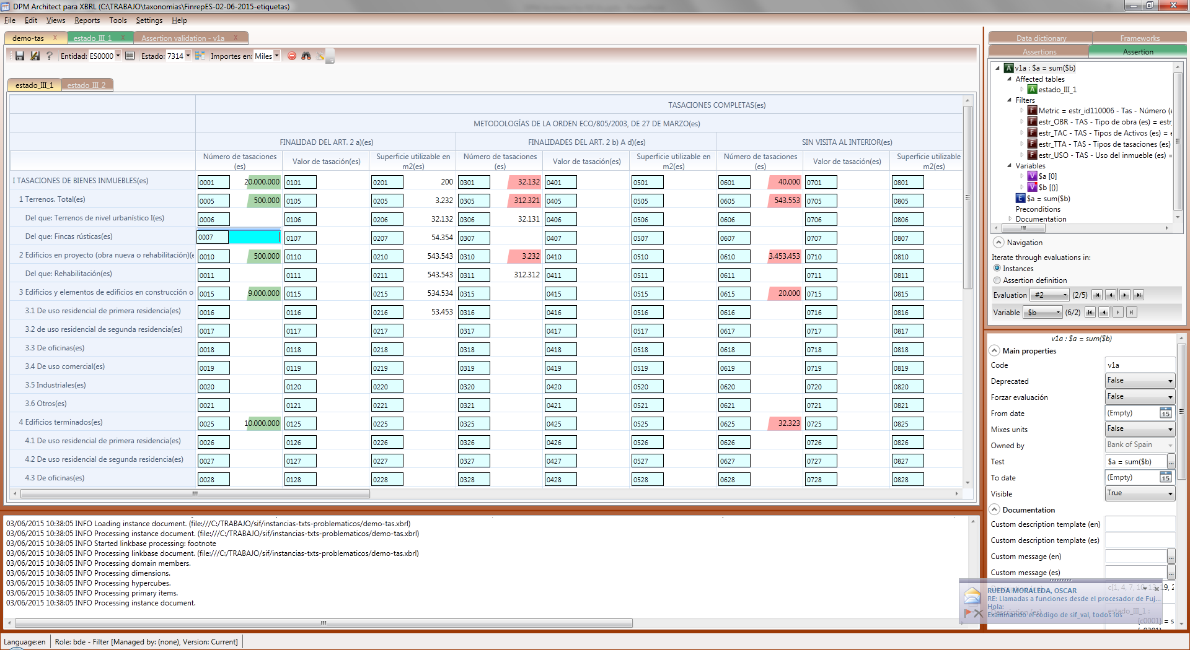
DPM: current situation
DPM tools
https://groups.google.com/forum/#!forum/dpm-architect

Slide 20

Questions?

Slide 21
hank ou!

